Slide 1
Crafting & Compelling Website Analysis, Audit and Recommendations

Slide 2
Apple Inc.: Today we will working on Apple website to perform website analysis , audit and recommendations
About Apple Inc.:
Apple Inc. is a global leader in technology, known for designing, manufacturing, and marketing a wide range of consumer electronics, software, and online services. Founded by Steve Jobs, Steve Wozniak, and Ronald Wayne in 1976, the company has grown to become one of the world's most valuable brands, with a strong reputation for innovation, quality, and user-centric design.

Slide 3
Apple Inc. Products and Services:
iPhone: Leading smartphone known for its advanced camera, powerful processors,
and seamless iOS experience.
Mac: Range of laptops and desktops with M-series chips, designed for
performance and creativity.
iPad: Versatile tablets with Apple Pencil support, used for work, education,
and entertainment.
Apple Watch: Smartwatch with fitness tracking, health monitoring, and
connectivity features.
AirPods: Wireless earbuds and headphones offering high-quality sound
and noise cancellation.
Apple TV: Streaming device providing access to TV shows, movies, and
Apple TV+ content.
App Store: Digital platform for apps, games, and software, curated for quality
and security.
Apple Music: Streaming service with a vast music library, curated playlists,
and exclusive content.
iCloud: Cloud storage service for secure file backup, synchronization, and
device integration.
Apple Pay: Secure, contactless payment service for easy transactions in
stores, apps, and online.

Slide 4
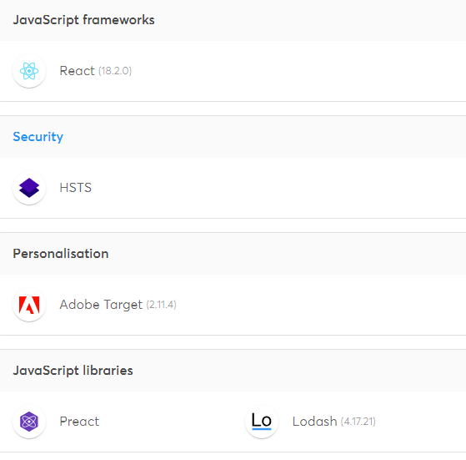
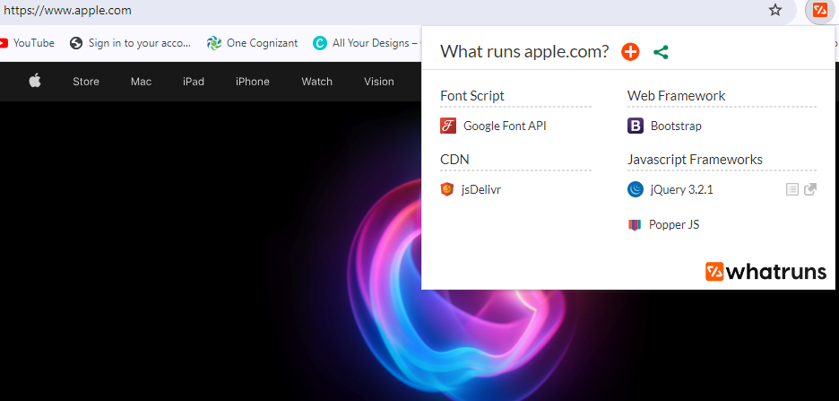
Website Platform Identification:
The website apple.com is developed using a combination of custom-built technologies, including advanced front-end frameworks like JavaScript and CSS, and server-side technologies, rather than relying on a specific off-the-shelf content management system (CMS). Tools like Wappalyzer or Whatruns can identify these technologies.

Slide 5
Responsive Design Testing: Tools used Google – Mobile friendly test, BrowserStack
Home Page: https://www.apple.com/ (Mobile-friendly with some minor alignment issues, particularly in banner sections.)
iPhone Product Page: https://www.apple.com/iphone/ (Fully responsive, but image optimization can be improved to enhance loading speed.)
Mac Product Page: https://www.apple.com/mac/ (Well-optimized for mobile, though text size can be increased for better readability.)
Support Page: https://support.apple.com/ (Responsive with a good user interface, though some dropdown menus need better touch optimization.)
Store Page: https://www.apple.com/store (Loads well, but some interactive elements need better placement to avoid overlapping.)
All tested pages on Apple’s website are highly optimized for mobile devices, with responsive elements, fast loading times, and touch-friendly navigation.

Slide 6
Website Mistakes Identification:
Here are some website design mistakes observed on Apple’s Website:
Cluttered Layout on Product Pages
Slow Loading Times Due to Heavy Media Content
Navigation Complexity
Lack of Clear Call-to-Action (CTA) Buttons
Accessibility Issues

Slide 7
Best Practices List:
Here are best practices for creating visually appealing and user-friendly website designs:
Simplify Navigation Structure.
Optimize Media for Faster Load Times.
Use High Contrast and Readable Fonts.
Emphasize Clear Call-to-Actions (CTAs).
Ensure Consistency Across Devices.
Incorporate White Space Strategically.
Focus on Minimalist Design.
Enhance Accessibility Features.
Regularly Test and Optimize for Performance.

Slide 8
Landing Page:
Here is the link for landing page design:
https://kavyasri93.wixsite.com/apple-1

Slide 9
Thank you

